Slide 1
AngularJS
$resource
A factory which creates a resource object that lets you interact with RESTful server-side data sources.
The returned resource object has action methods which provide high-level behaviors without the need to interact with the low level $http service.
Requires the ngResource module to be installed
https://docs.angularjs.org/api/ngResource
Then, include angular-resource.js in your HTML:
<script src="path/to/angular.js"></script>
<script src="path/to/angular-resource.js"></script>
Finally, load the module in your application by adding it as a dependent module:
angular.module('app', ['ngResource']);

Slide 2
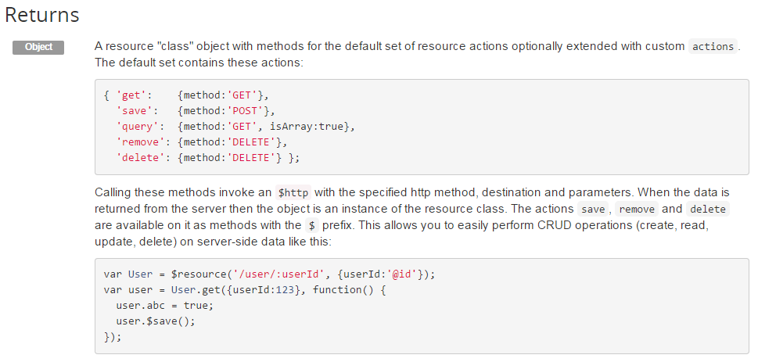
AngularJS
$resource
https://docs.angularjs.org/api/ngResource/service/$resource

